Slide 1
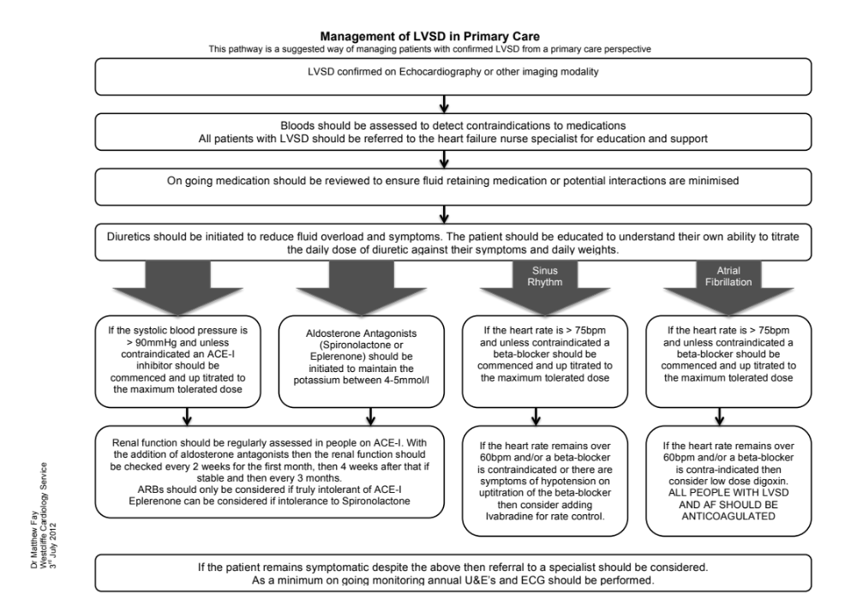
LVSD Pathway
The protocol embedded in SystmOne should be used when reviewing the patients with confirmed LVSD. This will bring consistency of intervention throughout the clinical team
The protocol endeavours to achieve the management of LVSD to optimise all prognostically significant medication to ensure the best care is obtained for the patients
The image below highlights what is the protocol is aiming to achieve for the patient

